Slide 1





e-Sustain App
Theme: Sustainability
Submitted By:
Shubham Garg
(Centre for Development of Advanced Computing) C-DAC, Noida Email: Shubham.Garg@studentambassadors.com Mobile: +91-7042381866

Slide 2
Objective
The aim is to design a local platform where local people, say people living in a locality, building, etc. can sell/donate/borrow/give the products to the needy ones which in other case would have been wasted.

Slide 3

Innovation
This platform is designed to remove the need of middle man, thus the platform is not controlled by a third party.
This is the first ever platform which is not based on particular service, i.e. every individual can use this platform.

Slide 4
Novelty
There are some organizations which work on the area of food wastage by picking up the leftovers from a party or a function. However there is no local platform available for people to directly interact and reduce the wastage.
Thus, there was a need to create a platform where people can post about any product (or waste product) which they intent to throw out like old clothes, leftover food, old gadgets etc.

Slide 5
Tech Stack
Microsoft Azure Power Apps
Microsoft Azure SQL
Microsoft Excel

Slide 6
Work Flow
Microsoft Azure Account
Azure Power Apps Services
Create an App using Azure Power app Services
Connect the Power App Services via SQL
Connect the SQL Services via Excel
Run the SQL Queries to perform CRUD Operations on data
User is provided with the GUI To perform CRUD in the Application
User can directly contact the local service provider via the details mentioned on the platform

Slide 7
Architecture
Microsoft Azure
Azure SQL Services
Microsoft Azure Power Apps
Microsoft Excel
SQL Queries
Database
App Main Screen
GUI
User Interaction
Addition/ Deletion of Data by the user on the platform

Slide 8
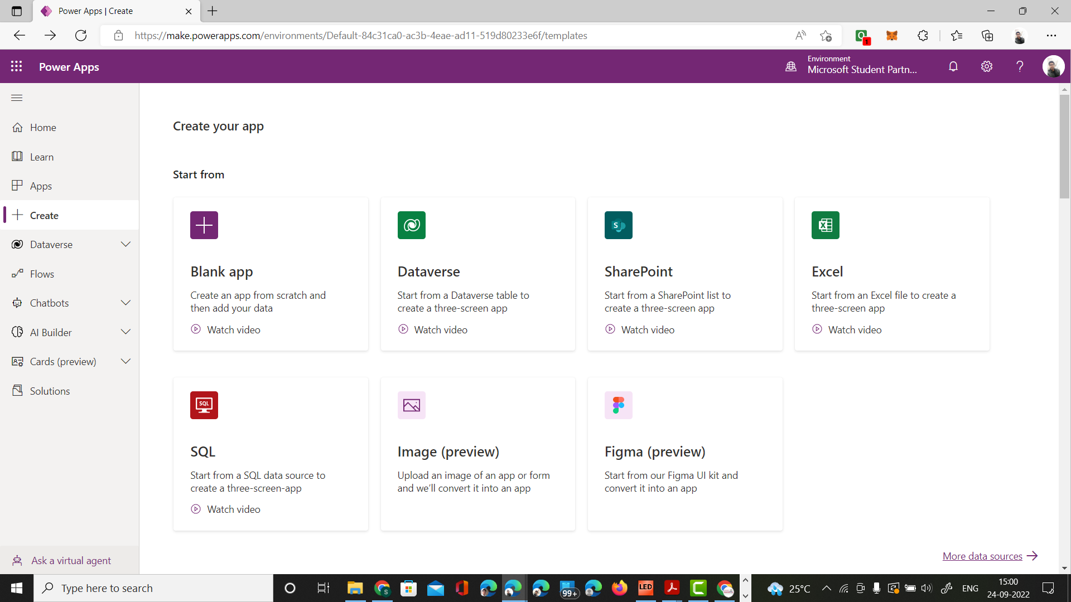
Screenshots of the Prototype
Microsoft Azure Power Apps Platform

Slide 9
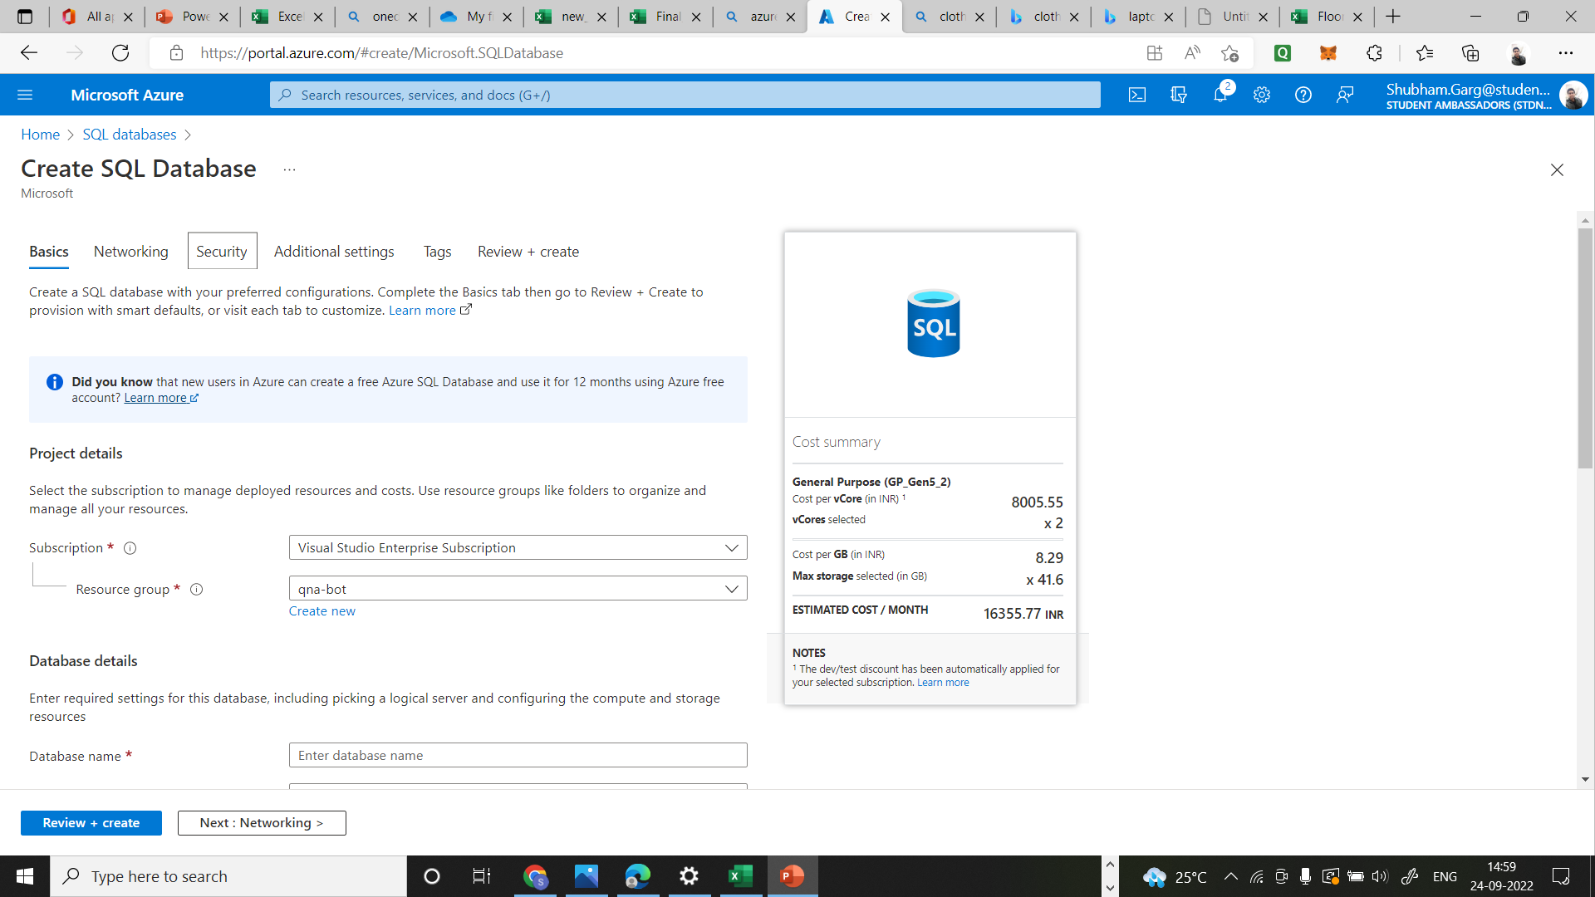
Creating SQL Database

Slide 10
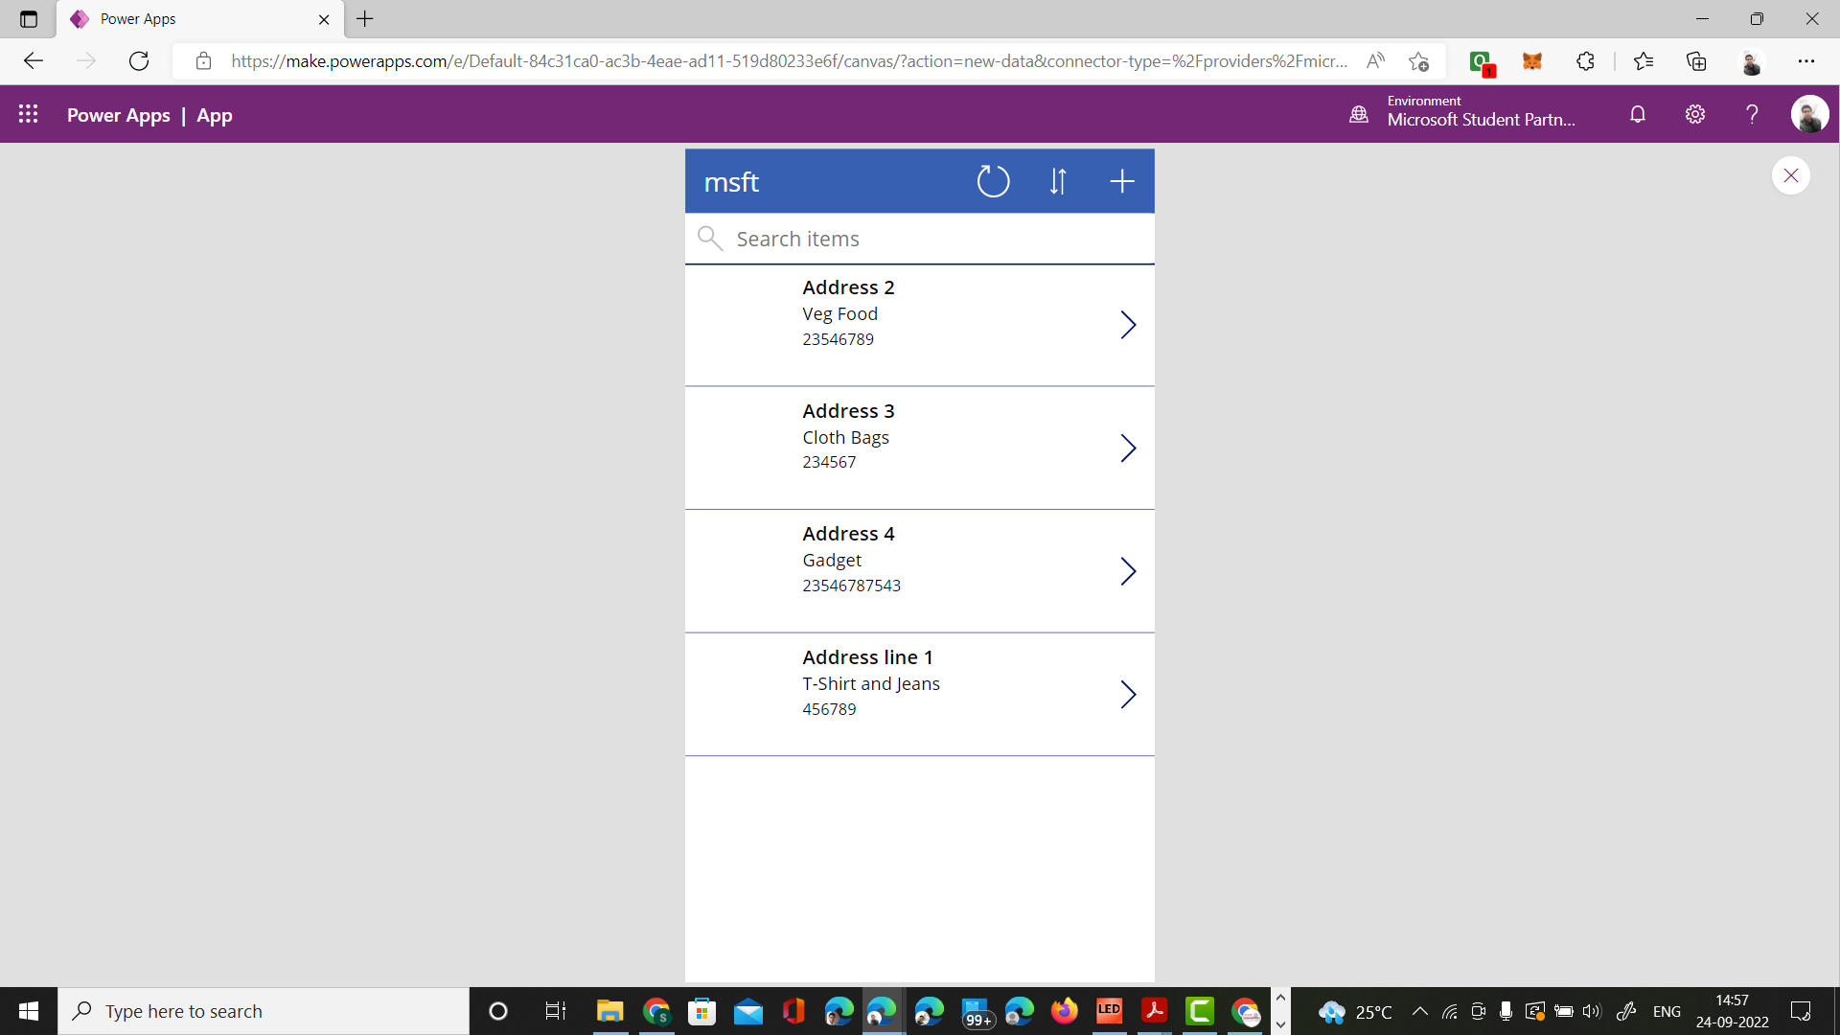
App Main Screen

Slide 11
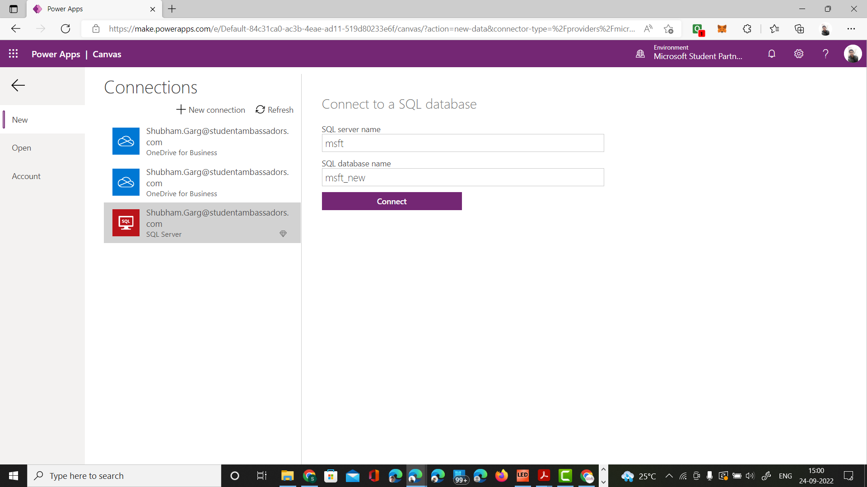
Connecting to SQL

Slide 12
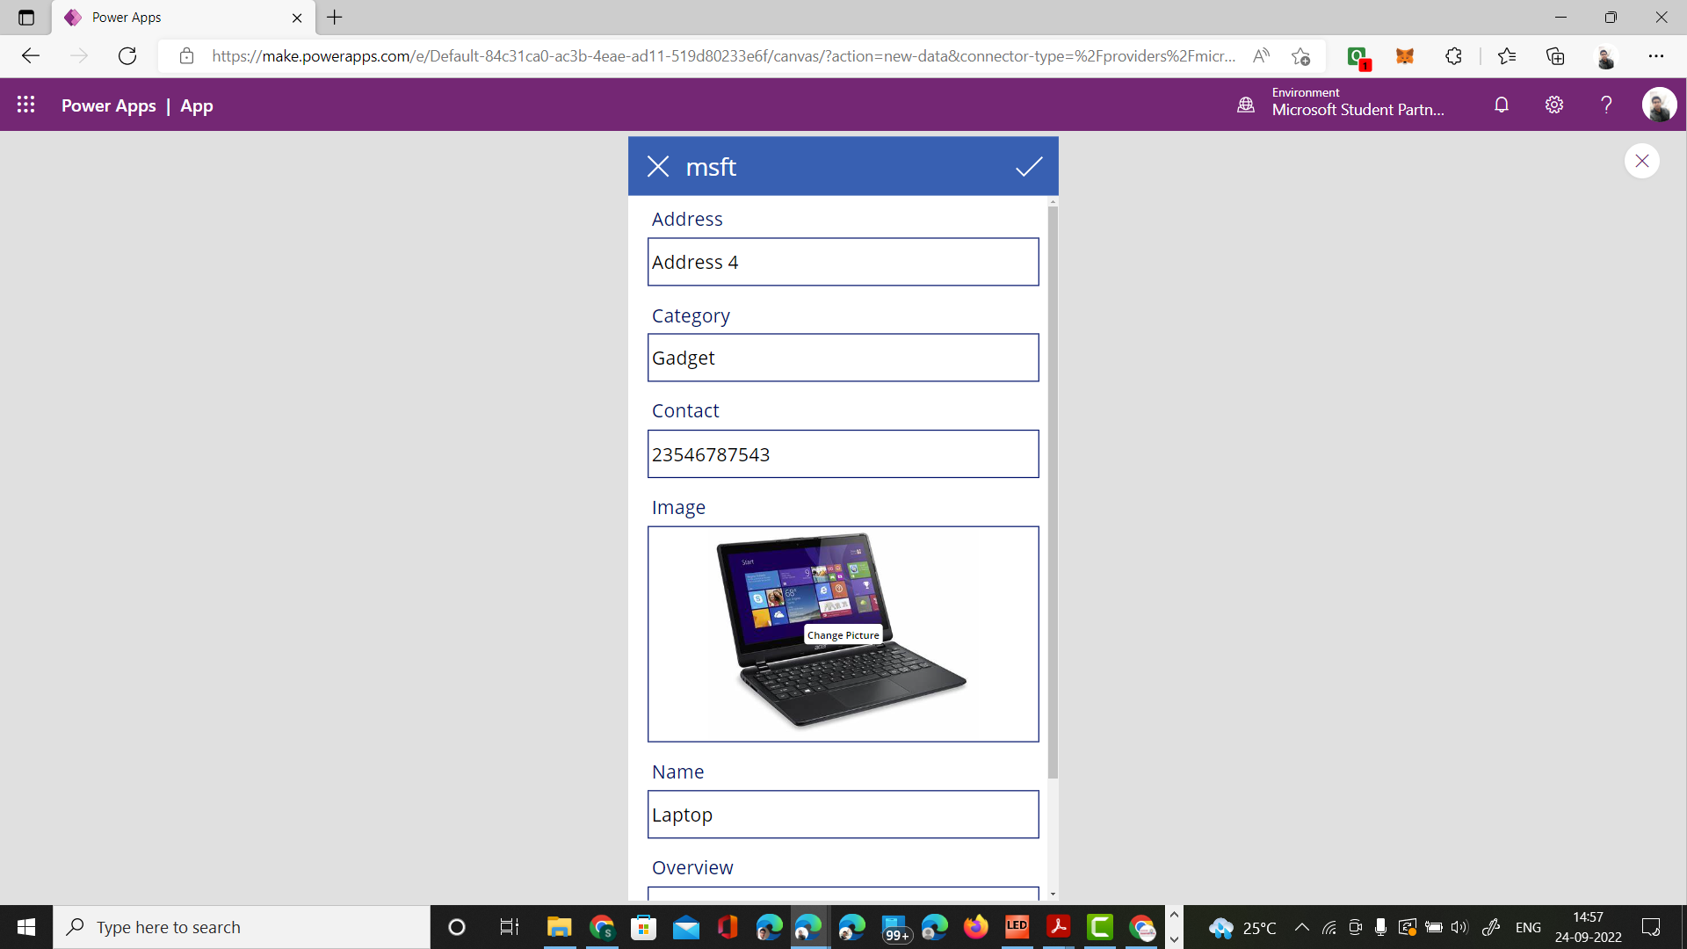
CRUD by User

Slide 13
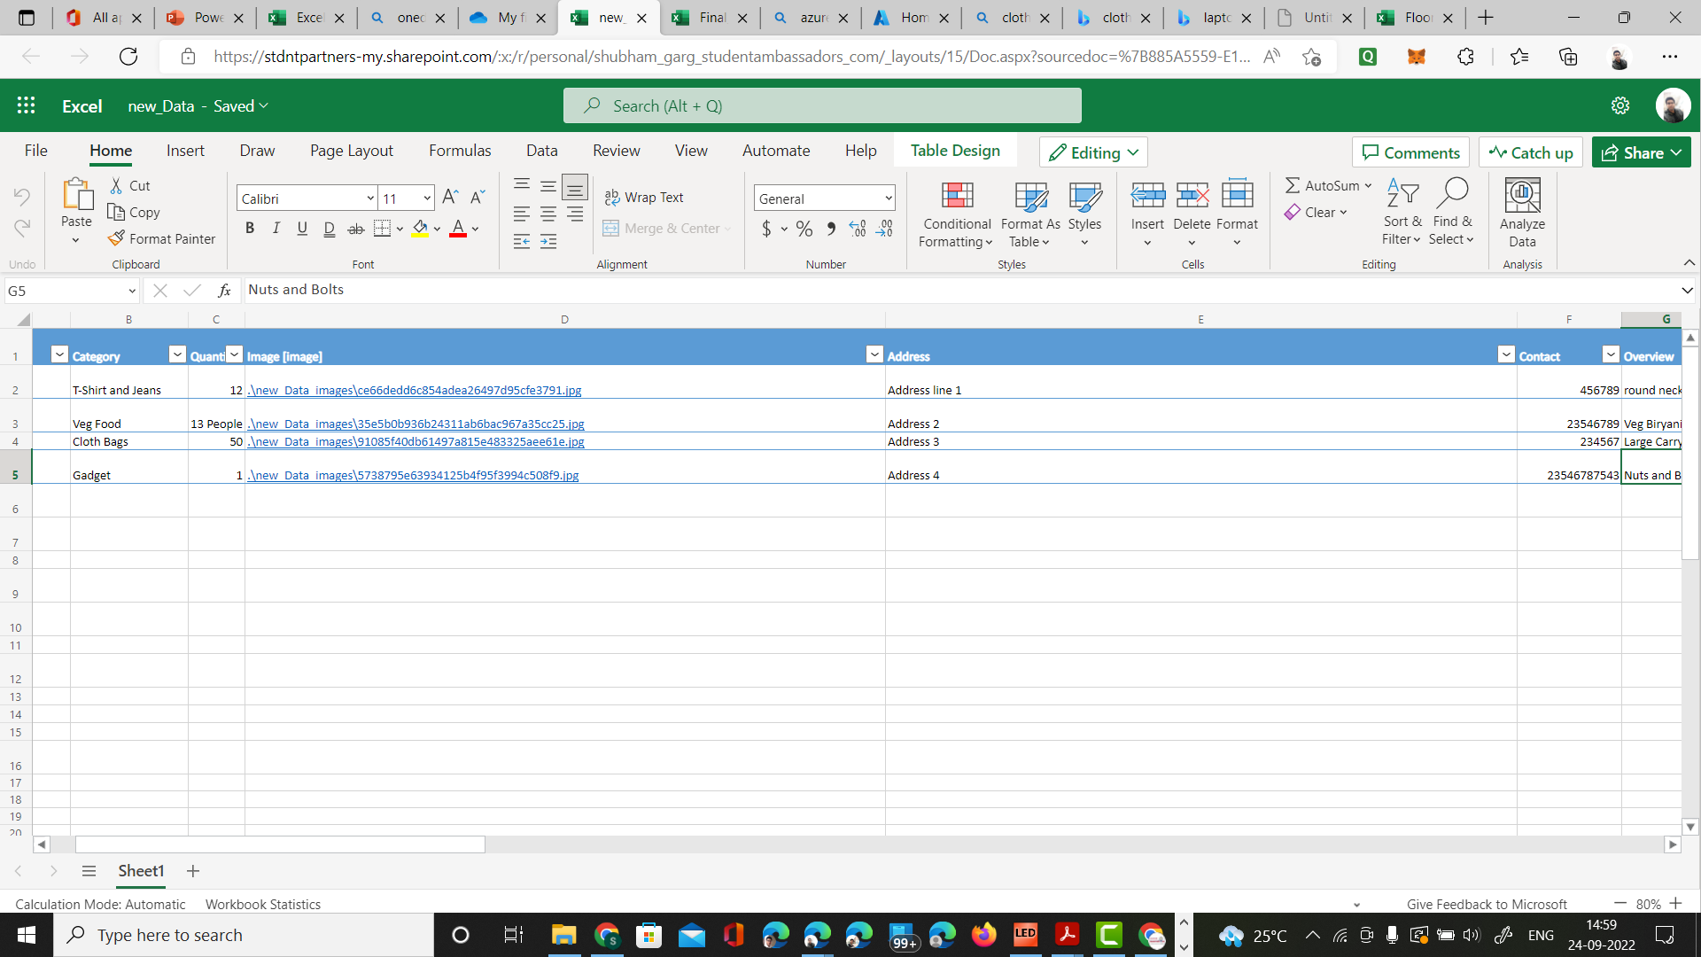
Data Stored in Microsoft Excel

Slide 14
Scalability
The App is Highly scalable because there is no limit for categories and the items that can be added.
Microsoft Azure database services can be used on large scale to manage database
Microsoft Azure Powerapps platform can handle the operations of the App easily, since the app is lightweight.

Slide 15
Social Impact
According to FAO (Food and Agriculture Organization) Global food loss and waste generate annually 4.4 GtCO2 eq, or about 8% of total anthropogenic GHG emissions
According to worldloop.org For every ton of e-waste collected and recycled; 1.44 tons of CO2 emissions are avoided.
Every time this app is used, and the wastage is stopped, we play our part in reducing the carbon footprint hence, saving the environment.

Slide 16
Thank You

